Slide 1
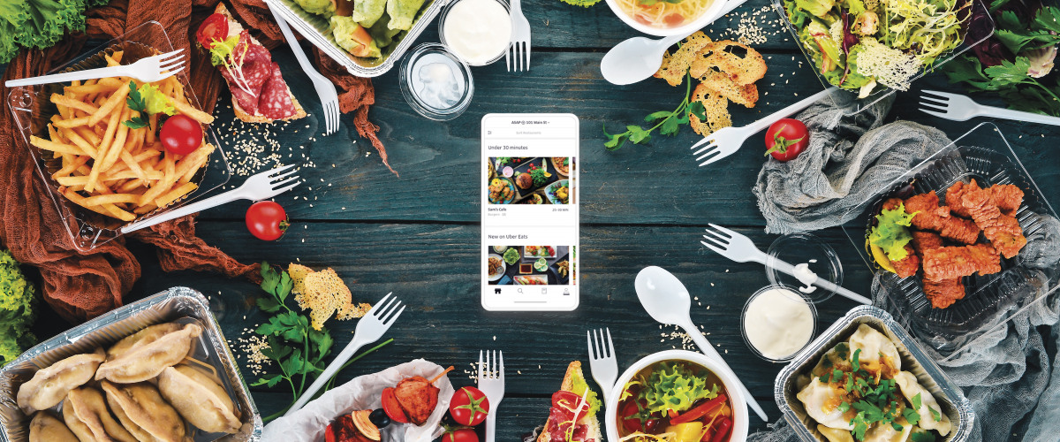
QuickBite Online Food Delivery System
Software Requirement Engineering Lab
Submitted To:
Ma’am Sanam Shoukat
Submitted By:
Alisha Kanwal (FA-23/BSSE/165-D)
Alina Irshad(FA-23/BSSE/199-D)
Department of Software Engineering
This Photo by Unknown Author is licensed under CC BY-SA-NC

Slide 2
Introduction
- Food delivery services are becoming an important part of daily life.
- Traditional ordering methods create delays and management problems.
- Customers face issues like delayed deliveries, wrong orders, and lack of order tracking.
- QuickBite provides a digital solution for online food ordering and delivery management.

Slide 3
Problem Statement
- Manual order handling
- Communication issues
- Order delays
- Poor order tracking
- Limited payment options

Slide 4
Proposed Solution:
QuickBite provides online food ordering, real-time tracking, secure payments, and delivery management.

Slide 5
Project Objectives
Provide
- Provide a user-friendly food ordering system
Reduce
- Reduce ordering mistakes and delays
Improve
- Improve communication between stakeholders
Support
- Support secure payment methods
Provide
- Provide real-time order tracking
Improve
- Improve restaurant order management

Slide 6
Stakeholders
• Customer – Places food orders
• Restaurant Owner – Manages menus and orders
• Delivery Rider – Delivers food
• System Administrator – Manages system
• Payment Service Provider – Handles payments

Slide 7
Functional Requirements
- User Registration & Login
- Search Restaurants & Food
- Add to Cart
- Place Orders
- Online Payment
- Cash on Delivery
- Order Tracking
- Ratings & Reviews
- Admin Management

Slide 8
Non-Functional Requirements
- Fast system response
- Secure password encryption
- User-friendly interface
- 24/7 availability
- Reliable data storage
- Mobile & web compatibility
- Scalability and maintainability

Slide 9
UML Diagrams
- Use Case Diagram
- Activity Diagram – User Registration
- Activity Diagram – Place Order
- Activity Diagram – Order Delivery Process

Slide 10
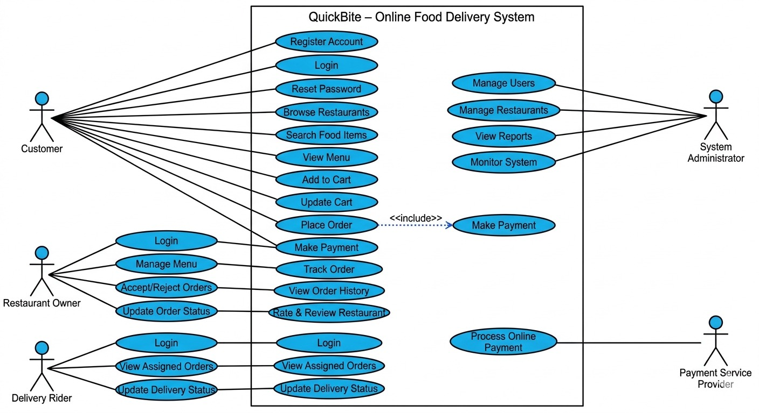
Use Case Diagram

Slide 11
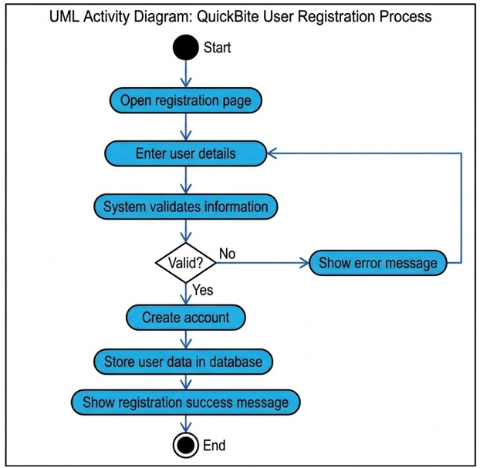
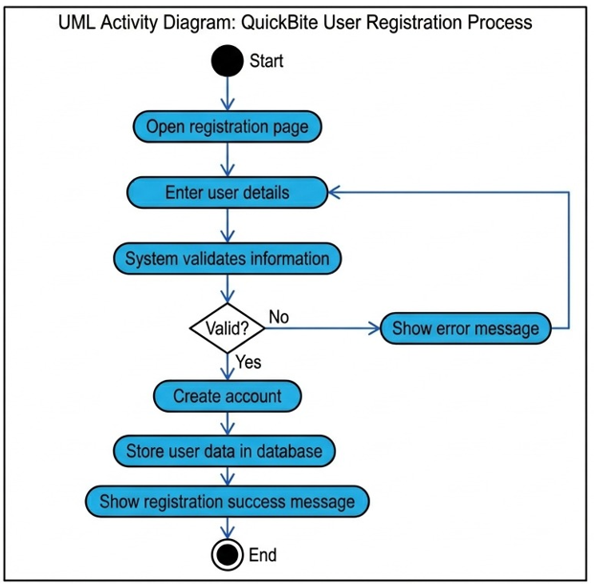

Slide 12
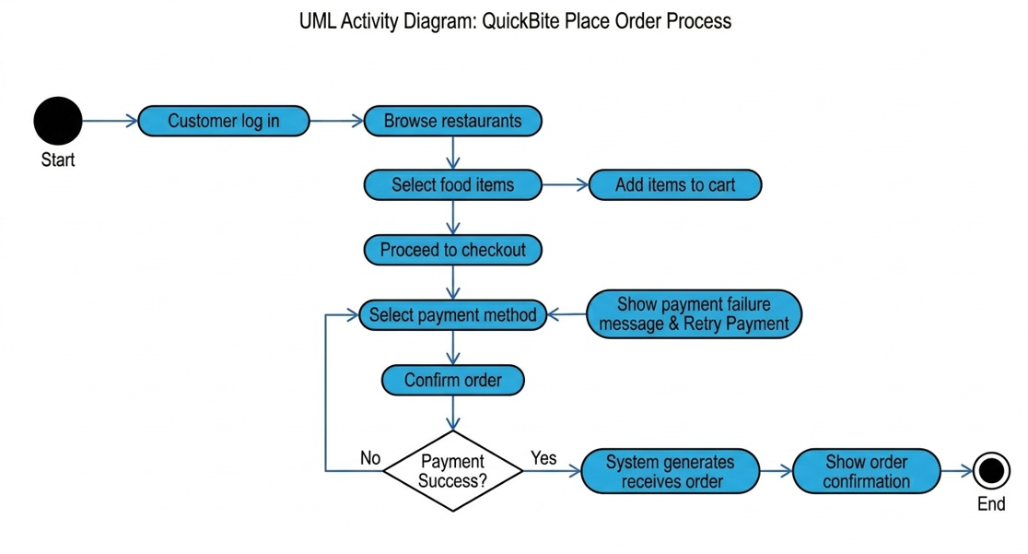

Slide 13
ERD & Database
- Customer
- Restaurant
- Menu Item
- Order
- Payment
- Delivery Rider
- Review

Slide 14
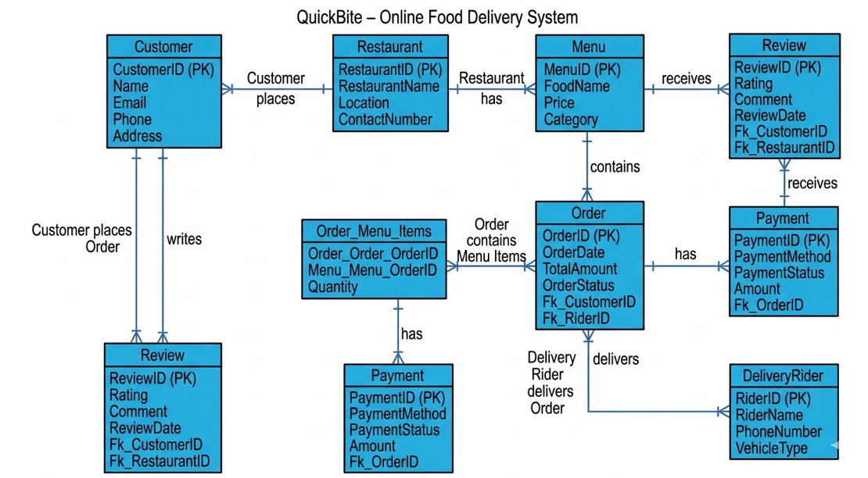

Slide 15
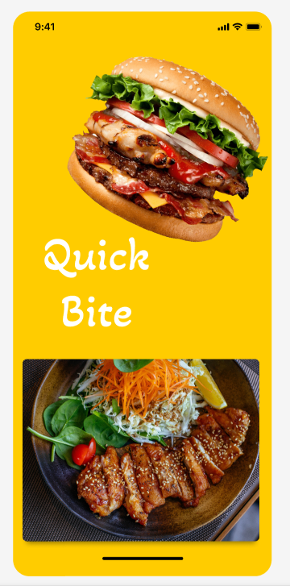
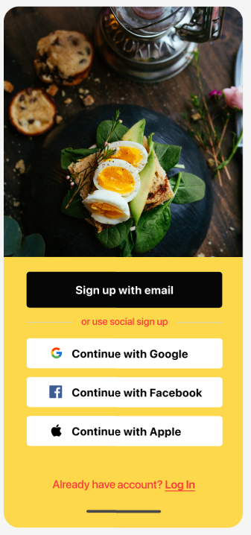
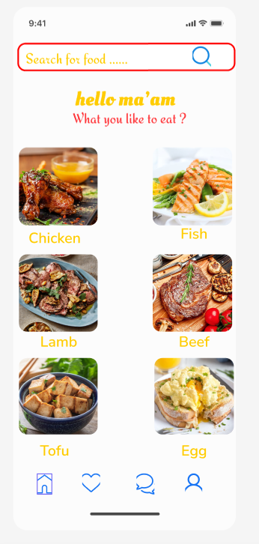
Figma Prototype

Slide 16
Tools & Technologies
Documentation – Microsoft Word
UML Modeling – draw.io
Prototyping – Figma
Collaboration – Google Drive

Slide 17
Conclusion
- QuickBite provides a simple and efficient online food delivery solution.
- The system improves food ordering and delivery management.
- The project helped in understanding Software Requirement Engineering concepts.
Thank You 😊

